Slide 1
AdiPlan - Global & Regional Marketing Plan Template
Issued March 2026
Prepared by: Impact Planning Group

Slide 2




© Impact Planning Group
AdiPlan: The Adisseo Way of Marketing planning model - outside-in & question-based
III. Executing
How can we go to market as we monitor & measure our progress?
I. Assessing
What are our insights about the market & customers – now & future?
Customers’ Needs
And Adisseo’s
Business Goals
II. Creating
How can we create solutions & campaigns that provide value to customers?

Slide 3
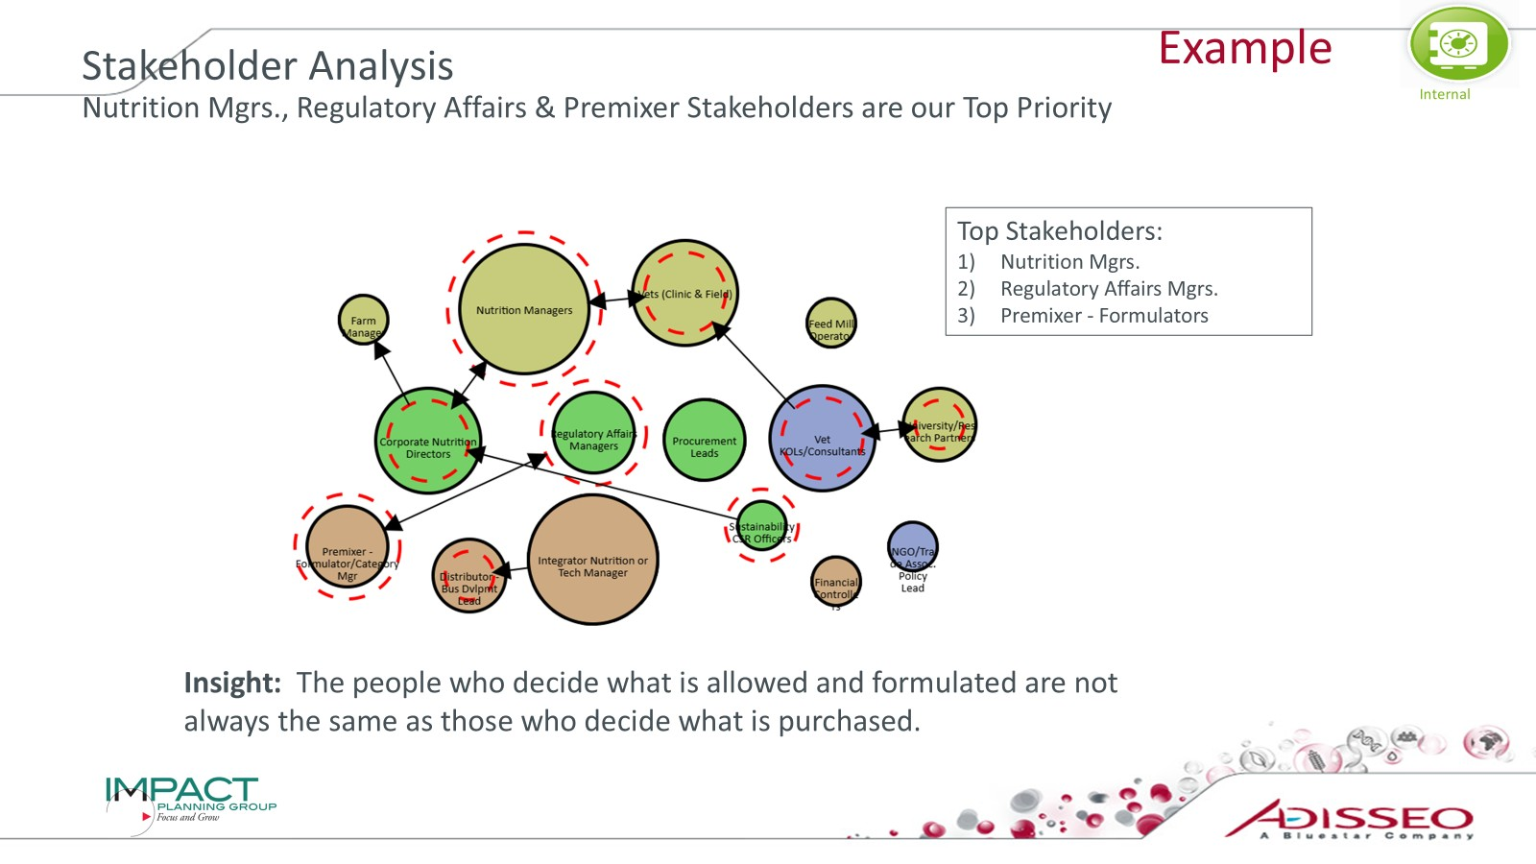
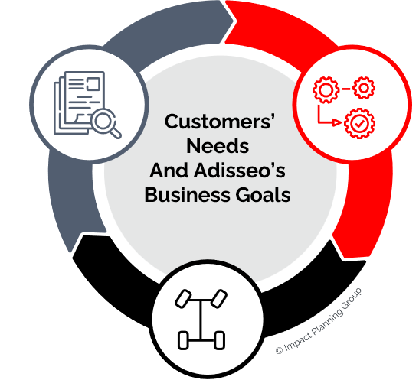
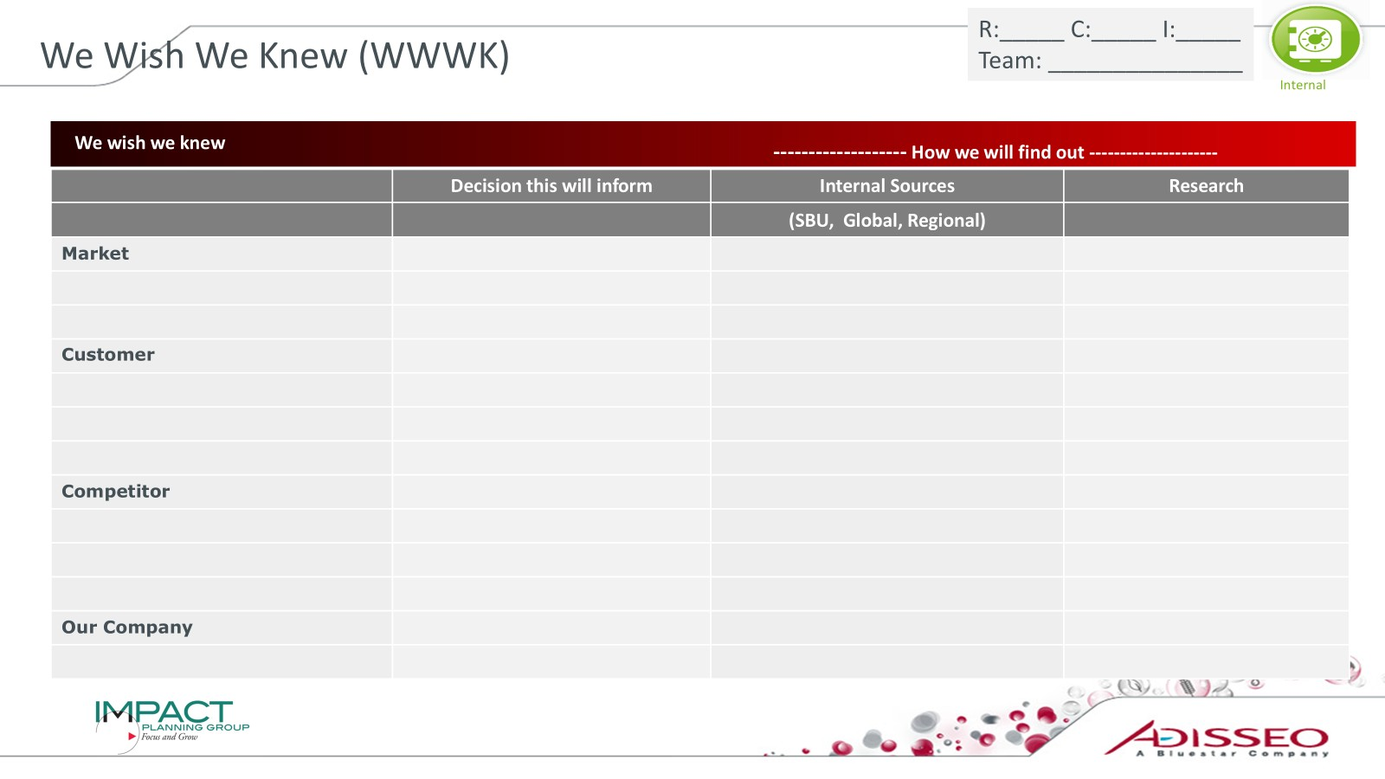
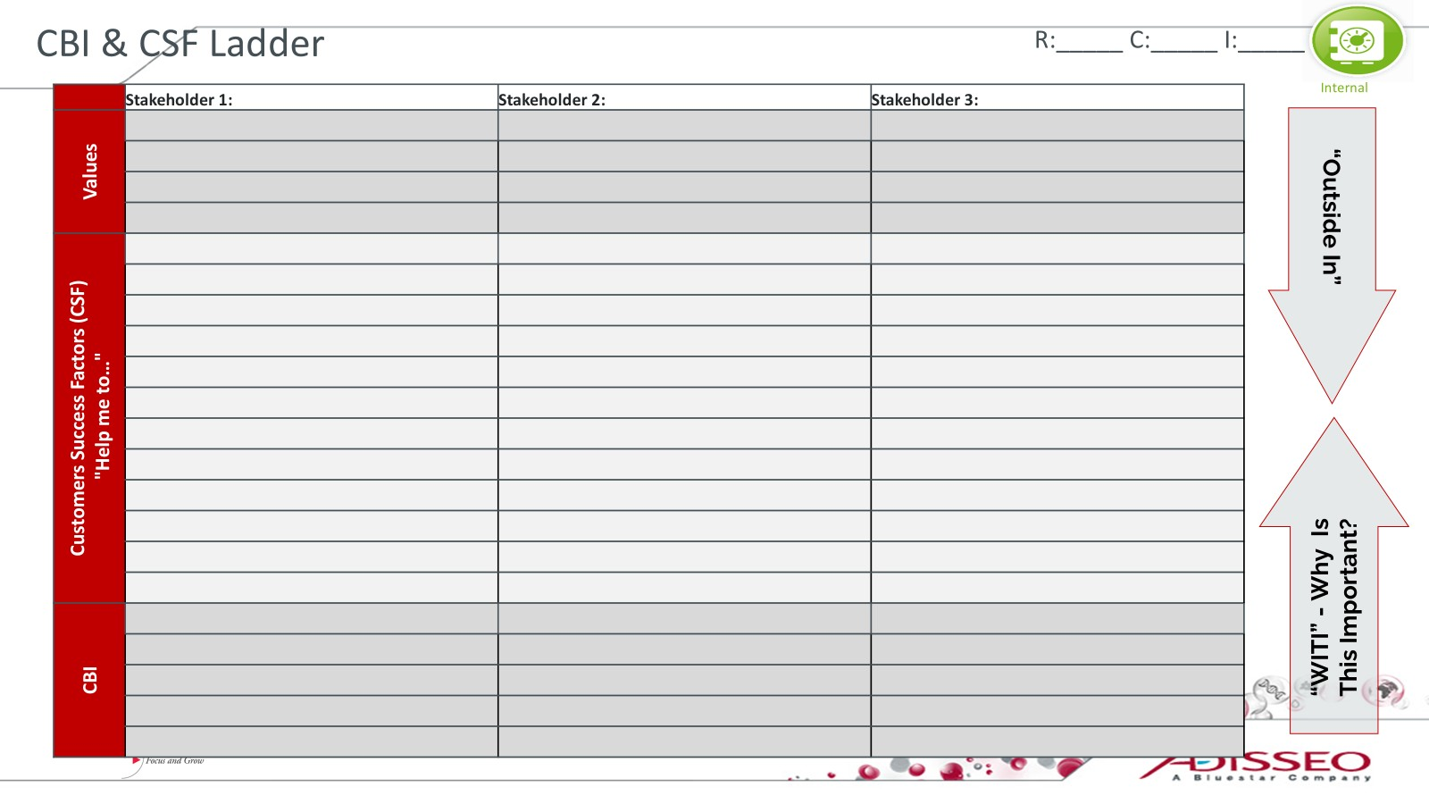
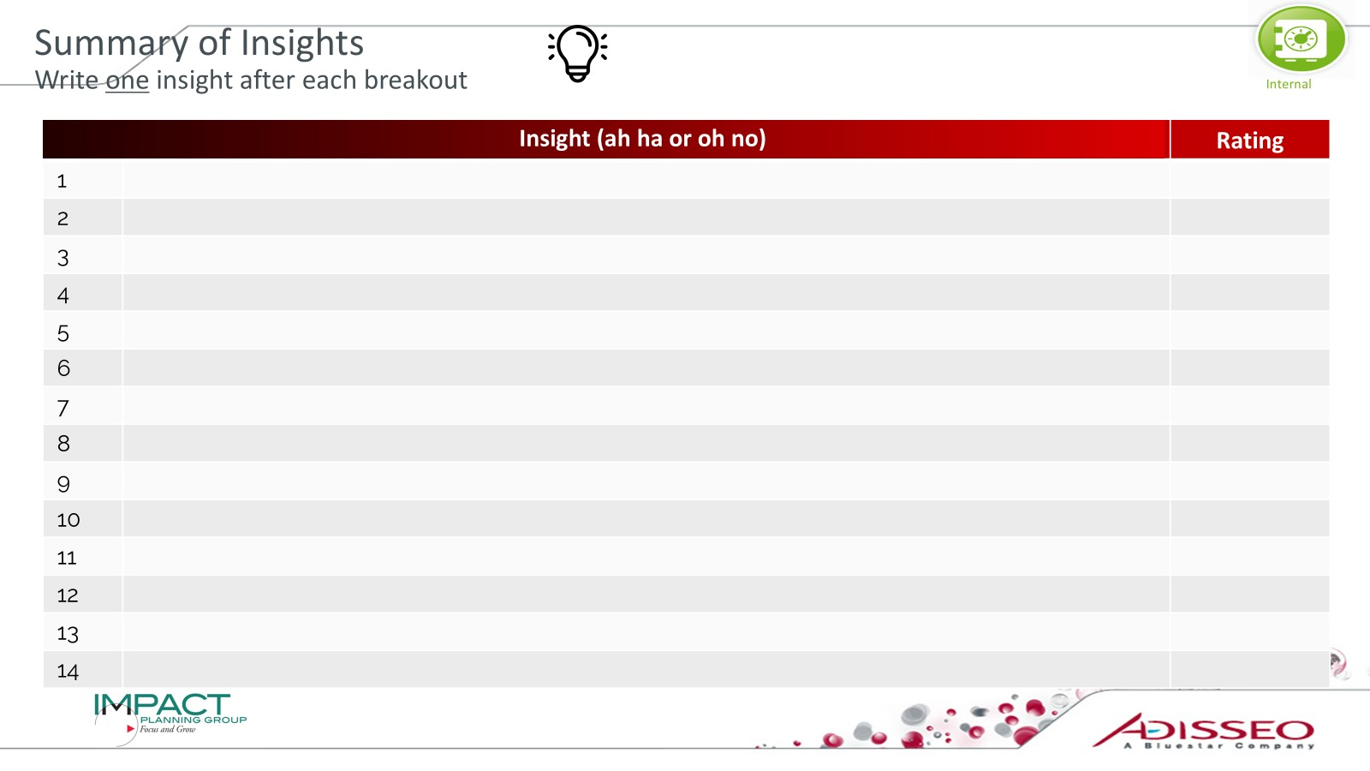
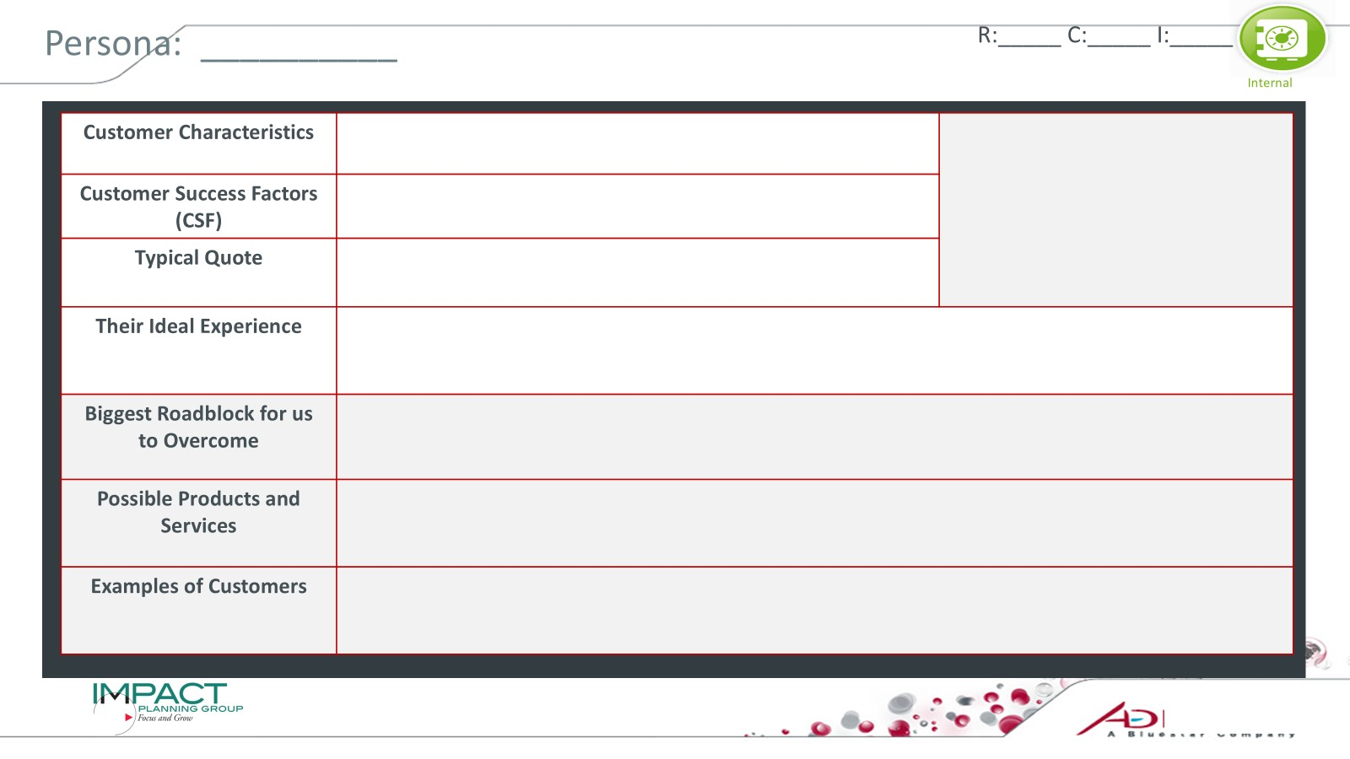
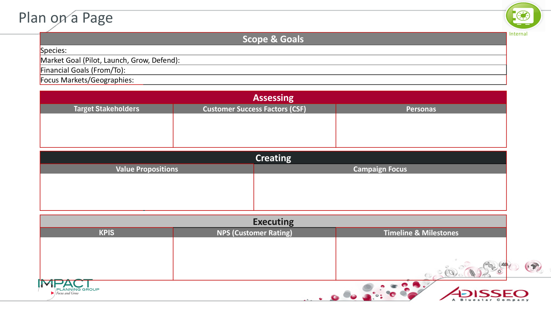
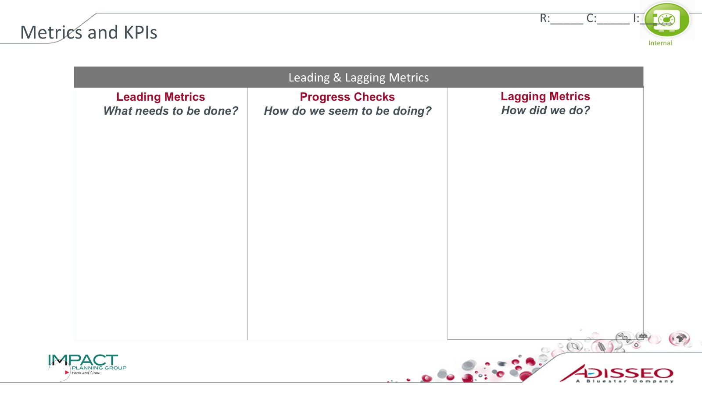
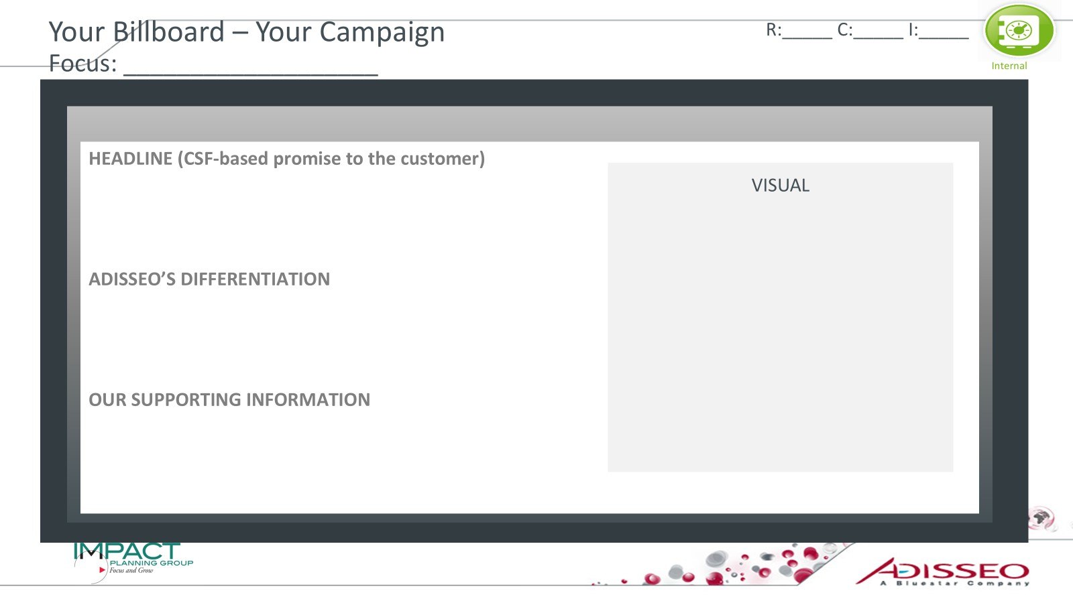
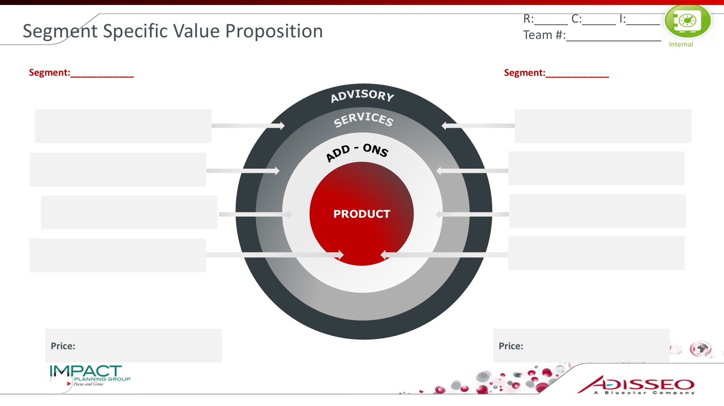
AdiPlan Roadmap (Assessing/Creating/Executing)
Stakeholder Analysis
We Wish We Knew
CBI & CSF Ladder
Insights
Enterprise Personas
Plan on a Page
KPIs
Campaign
Total Value Solution
COPYRIGHT: IMPACT PLANNING GROUP. ALL RIGHTS RESERVED

Slide 4
Plan on a Page
Scope & Goals
Species:
Market Goal (Pilot, Launch, Grow, Defend):
Financial Goals (From/To):
Focus Markets/Geographies:
Assessing
Target Stakeholders |  |  | Customer Success Factors (CSF) | Customer Success Factors (CSF) |  |  | Personas | Personas
Creating
Total Value Solution |  |  | Value Propositions | Campaign Focus |  |  |  | Campaign Focus
 |  |  | (Link to Value Prop) Products: Alterion + Selisseo, Rovabio + Adimix Services: Support: |  |  |  |  | (Link to Campaign) Stronger Performance. Fewer Setbacks. Faster Results
Executing
KPIs |  |  |  |  |  | Timeline & Milestones | Timeline & Milestones
 |  |  |  |  |  |  |  | (Link to Tracker Template) Q3 2025 –Campaign 1 focused on early resilience Q4 2025 – Campaign 2 targeting diarrhea control Q1 2026 – Extend to China, gather data for regional proof

Slide 5
Stakeholder Map
List Stakeholders (Decision makers and Influencers) | Level of current influence (small, medium, large) | Future Level of Influence (growing, shrinking, not changing)
COPYRIGHT: IMPACT PLANNING GROUP. ALL RIGHTS RESERVED

Slide 6
Decision Makers and Influencers
Size of Circles Indicate Extent of Influence on Purchasing Decisions
Dotted lines indicate growing or shrinking in influence in the future
Our Priorities Regarding Stakeholders
Before this Analysis | After this Analysis
1. | 1.
2. | 2.
3. | 3.
COPYRIGHT: IMPACT PLANNING GROUP. ALL RIGHTS RESERVED
Notes:
6

Slide 7
Who Are Our Customers - Instructions
Identify all decision makers and influencers in your target sector
Note: these are people (who you could potentially talk with)
Draw Influencer Map
Circles represent customer groups
Size of circle denotes how much influence the customer group has
Customer groups can have sub-groups within them
Dotted Circles represent the size of influence in the future
If something is getting bigger – something is getting smaller
Trends can have an impact on these changes
Lines and arrows - connect direction of influence with arrows
Keep your company and competitors off the map – this is a power map, not an org chart!
What are our priorities now? Future? Are there leverage points? Where must we win to scale Solution Selling?
What is your insight?
COPYRIGHT: IMPACT PLANNING GROUP. ALL RIGHTS RESERVED

Slide 8
CBI & CSF Ladder
R:_____ C:_____ I:_____
 | Stakeholder 1: | Stakeholder 2: | Stakeholder 3:
Values
Customers Success Factors (CSF) "Help me to…"
CBI
“Outside In”
“WITI” - Why Is
This Important?
COPYRIGHT: IMPACT PLANNING GROUP. ALL RIGHTS RESERVED

Slide 9
CBI & CSF Ladder - Instructions
Select 3 Target Stakeholders
Choose clearly defined group (e.g., Integrator, Nutrition Manager, Feed Mill, Distributor, Large Farm). Be specific
Define Their Customer Success Factors (CSFs) (No CAB-bage!)
Identify the outcomes they must achieve — from any supplier, not just Adisseo.
Think in “Help me to…” language:, “Help me keep performance predictable.” ”Help me protect margin.” Help me manage risk under regulation.”
If it sounds like a product, technology, or topic — you are still at CBI level.
If needed, start from CBIs (heat stress, FCR, PRRS, RM variability) — then ladder up.
Identify the Underlying Values (WITI)
Ask: Why is this important? What risk, identity, or pressure is driving their decisions?
Examples: “I must deliver consistent results “I cannot afford surprises.” “I am accountable for performance.”
Circle the Top 5 non-overlapping CSFs for Each Stakeholder
Capture One Strategic Insight
Write one headline insight on the Insights Chart: e.g., “We are solving heat stress symptoms, but customers are buying predictability.”
COPYRIGHT: IMPACT PLANNING GROUP. ALL RIGHTS RESERVED

Slide 10
Enterprise Personas
 | Enterprise Personas
CSFs (“Help me to…”)
Percentage of customers in this persona (Large, Med, Small):
Attractiveness to Adisseo (High, Med, Low):
COPYRIGHT: IMPACT PLANNING GROUP. ALL RIGHTS RESERVED

Slide 11
Build Your Enterprise Personas
Confirm Your 5 CSFs
Choose the top 5 from your Laddering exercise
If more than one stakeholder from your Laddering exercise was from the same enterprise, choose a couple CSFs from each
Create the Diagonal Ones
Assign one clear #1 priority per persona. Rank remaining CSFs (#2–#5).
If two columns look the same, merge them..
Name the Personas
Name them based on their top priority.
Avoid species, region, or account size labels.
Estimate the percentage of customers in each Persona in your market
Identify the metric used for “size” and label the Persona.
Capture One Insight: What Changes If This Is True?
COPYRIGHT: IMPACT PLANNING GROUP. ALL RIGHTS RESERVED

Slide 12
Enterprise Persona: __________
R:_____ C:_____ I:_____
Customer Characteristics
Customer Success Factors (CSF)
Typical Quote
Their Ideal Experience
Biggest Roadblock for us to Overcome
Possible Products and Services
Examples of Customers
COPYRIGHT: IMPACT PLANNING GROUP. ALL RIGHTS RESERVED

Slide 13
Total Value Solution Categories Map to the Adisseo Offer
ADVISORY
S
SERVICES
DATA, DIGITAL & STRATEGIC ADVISORY
ADD - ONS
PRODUCT
SERVICES & OPERATIONAL SUPPORT
APPLICATION & PERFORMANCE ADD-ONS
PRODUCTS & TECHNOLOGIES
COPYRIGHT: IMPACT PLANNING GROUP. ALL RIGHTS RESERVED

Slide 14
Adisseo Master List – Species: ____
PRODUCTS & TECHNOLOGIES
APPLICATION & PERFORMANCE ADD-ONS
SERVICES & OPERATIONAL SUPPORT
DATA, DIGITAL & STRATEGIC ADVISORY

Slide 15
Total Value Solution
CSF:____________
CSF:____________
ADVISORY
S
SERVICES
ADD - ONS
PRODUCT
Price:
Price:
COPYRIGHT: IMPACT PLANNING GROUP. ALL RIGHTS RESERVED

Slide 16
Total Value Solution – Instructions Turning Strategy into a Coherent Offer
Select Two CSFs
Anchor on Priority CSFs
Build the offer around the top 2–3 outcomes that matter most.
Define the Architecture of Value
Specify what we will commit to across
Core Products & Technologies
Application / Performance Programs
Services & Operational Support
Data, Digital & Advisory
Make Explicit Tradeoffs
What are we prioritizing?
What are we not emphasizing?
Test for Coherence
Is it:
Focused (not everything for everyone)?
Differentiated (vs. competitors)?
Executable (clear cross-functional commitments)?
Capture the Insight
What must align internally for this to work?
COPYRIGHT: IMPACT PLANNING GROUP. ALL RIGHTS RESERVED

Slide 17
Your Billboard – Your Campaign Focus: ___________________
HEADLINE (CSF-based promise to the customer)
ADISSEO’S DIFFERENTIATION
REASON TO BELIEVE
VISUAL
COPYRIGHT: IMPACT PLANNING GROUP. ALL RIGHTS RESERVED

Slide 18
Billboard Campaign - Instructions
Objective: Translate your Persona + differential advantage into a message that is: Unique. Important. Believable.
Select Two Different Enterprise Personas
Build two billboard concepts, one for each.
Anchor on one priority CSFs
Each concept should focus on one dominant outcome. Do not try to say everything.
Write the Headline and Create a Visual
Clear business outcome. Reflects real differentiation. Readable in 3–5 seconds
(Not a product feature.)
Complete the “Adisseo Differentiation” and “Reason to Believe” Sections
Apply the 3 Tests
Unique vs. competitors?
Important to this segment?
Believable based on evidence?
Create Two Distinct Concepts
Make sure each speaks to the target persona.
COPYRIGHT: IMPACT PLANNING GROUP. ALL RIGHTS RESERVED

Slide 19
Metrics and KPIs
Leading & Lagging Metrics
Leading Metrics
What needs to be done?
Progress Checks
How do we seem to be doing?
Lagging Metrics
How did we do?
COPYRIGHT: IMPACT PLANNING GROUP. ALL RIGHTS RESERVED

Slide 20
Plan on a Page
Scope & Goals
Species:
Market Goal (Pilot, Launch, Grow, Defend):
Financial Goals (From/To):
Focus Markets/Geographies:
Assessing
Target Stakeholders |  |  | Customer Success Factors (CSF) | Customer Success Factors (CSF) |  |  | Personas | Personas
Creating
Total Value Solution |  |  | Value Propositions | Campaign Focus |  |  |  | Campaign Focus
 |  |  | (Link to Value Prop) Products: Alterion + Selisseo, Rovabio + Adimix Services: Support: |  |  |  |  | (Link to Campaign) Stronger Performance. Fewer Setbacks. Faster Results
Executing
KPIs |  |  |  |  |  | Timeline & Milestones | Timeline & Milestones
 |  |  |  |  |  |  |  | (Link to Tracker Template) Q3 2025 –Campaign 1 focused on early resilience Q4 2025 – Campaign 2 targeting diarrhea control Q1 2026 – Extend to China, gather data for regional proof

Slide 21
We Wish We Knew (WWWK)
 | Decision this will inform | Internal Sources | Research
 |  | (SBU, Global, Regional)
Market
Customer
Competitor
Our Company
We wish we knew
------------------- How we will find out ---------------------
COPYRIGHT: IMPACT PLANNING GROUP. ALL RIGHTS RESERVED

Slide 22

Summary of Insights Write one insight after each breakout
Insight (ah ha or oh no)
 |  | Rating
1
2
3
4
5
6
7
8
9
10
11
12
13
14
COPYRIGHT: IMPACT PLANNING GROUP. ALL RIGHTS RESERVED

